Slide 1
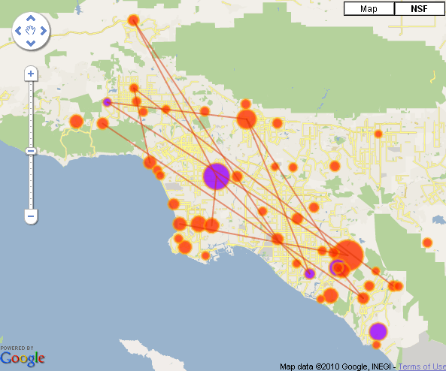
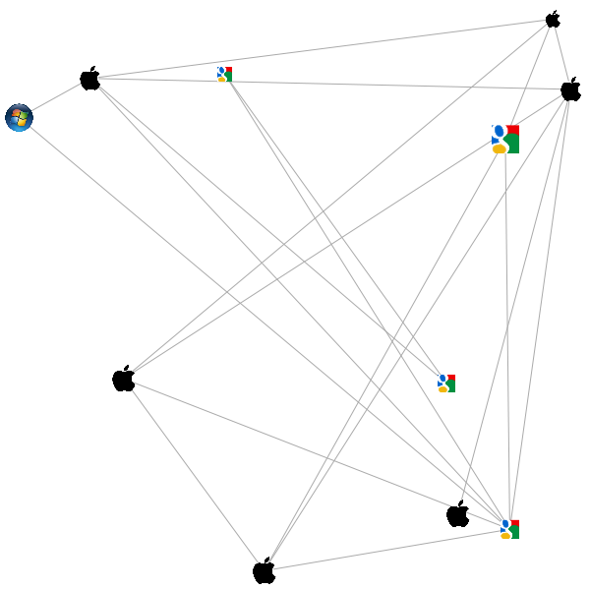

Slide 2
Data Elements
INVENTOR
Invnum_N | Unique inventor number.
Name | Inventor name
Inv_Seq | Inventor number on patent.
ASSIGNEE
Assignee | Primary firm associated with patent.
Numasg | Generated assignee number.
PATENT
Invpatseq | Generated patent history sequence for inventor.
Pat_Type | 94% Utility (U), 5% Design (D).
Patent | USPTO assigned patent number.
AppDate | Patent application date.
GDate | Patent grant date.
Claims | Total patent claims.
CLASSES
Classes | Classes separated by “|”. Main-Sub. Primary class listed first. 10 maximum.
INVENTOR LOCATION
City | Inventor’s city.
Loc | (US only) State or Country code.
Zipcode | (US only) Zipcode.

